Slide 1

Understanding GPU Feature Importance
By Brody Hill

Slide 2
The Problem:
You’re intel and you’ve just released your first line of GPUs.
AMD and NVIDIAs cards are crushing your best cards in rasterization performance. You need to understand which GPU features most impact performance so you can invest accordingly.

Slide 3
The Solution:
Invest heavily into cards with more texture mapping units and render output units.
Notes:
These two features were most important as identified by my best model. Let’s walk through how I got there.

Slide 4

The Data:
I used two datasets here.
Dataset 1: GPU Hardware Features
Dataset 2: GPU 3DMark Performance

Slide 5
Data Wrangling:
After merging my two datasets together on the GPU column, I had 1088 rows and 24 columns.
After examining and cleaning I had 786 rows and 17 columns.
What actions did I take to get there?
Dropped all duplicate GPUs, there were 134.
Dropped columns that had over 20% of their data missing, there were seven.
Created histograms and checked for outliers, there were not any suspicious values.
Dropped any remaining rows that still contained missing values

Slide 6
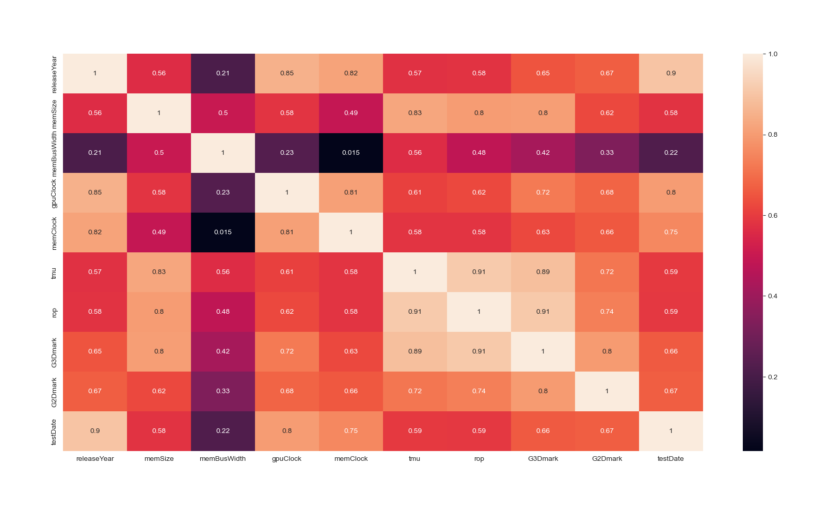
Exploratory Data Analysis Part 1:
Notes:
I began EDA with a heatmap to get a high-level understanding of which features were most correlated with our target feature, G3Dmark.
Our top four features were:
Render Output Units (ROP)
Texture Mapping Units (TMU)
Graphics Memory Clock Speeds
GPU Clock Speeds
We’ll see how this aligns when we look at our final models feature importance.

Slide 7
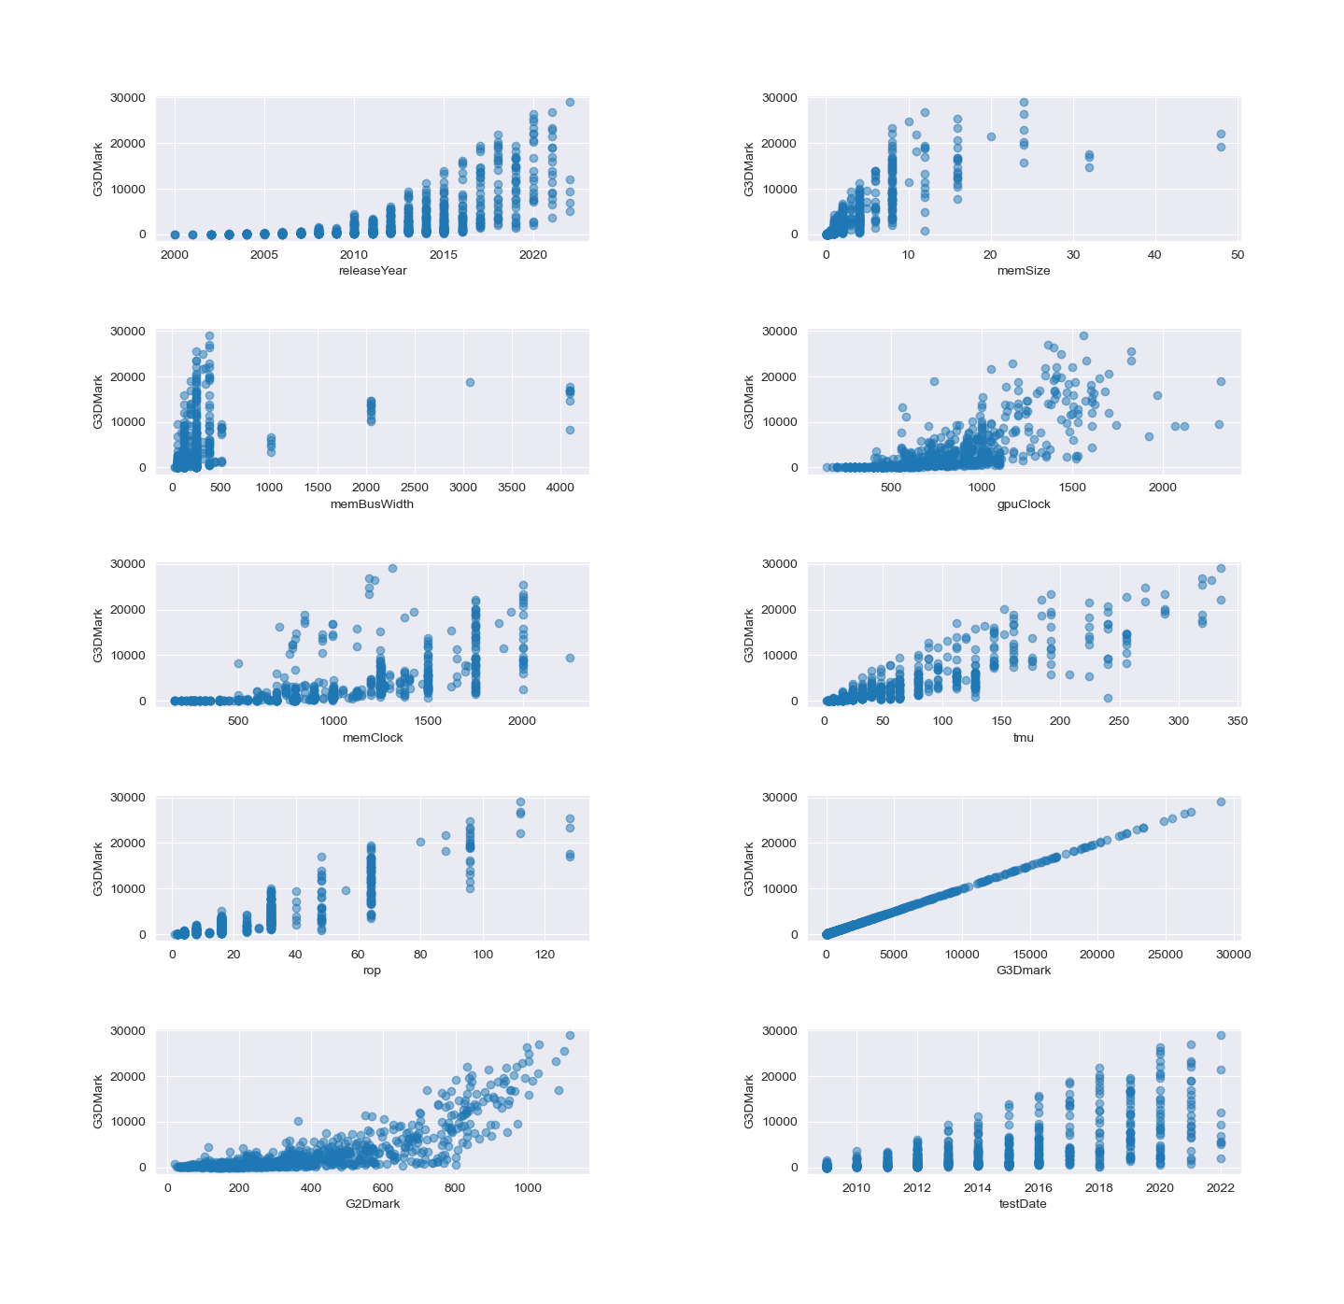
Exploratory Data Analysis Part 2:
Notes:
After my heatmap, I created scatter plots to get a sense for how my features were distributed.
ROPs and TMUs appeared most linear, with memory and GPU clocks speeds seeming not so much linear, but simply more dispersed as clocks speeds increased. So higher speeds don’t necessarily mean higher scores, but lower clock speeds to almost always result in lower scores. Release year was interesting too. Scores don’t necessarily go up over time, the distribution just gets wider.

Slide 8
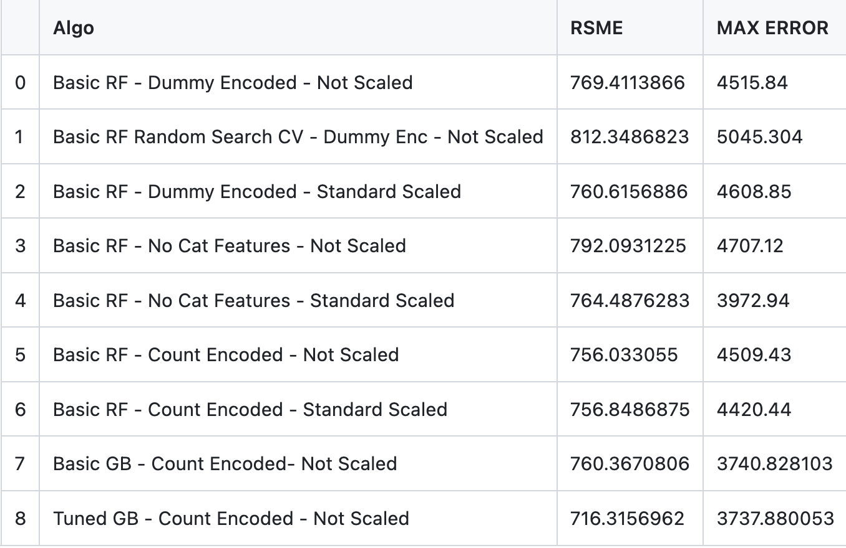
Model Results:
Notes:
I tested eight different models and compared the RMSE and Max Error across all eight.
If scaling was done, it was done using scikit learns standard scaler object.
I encoded two different ways, dummy encoding and count encoding. Dummy encoding left me with close to 1000 features and slowed down train and fit times. Count encoding did not increase my feature space or slow things down, and performed the same or better.
I hyperparameter tuned my initial RF model, but results were worse. Still looking into why that was happening, but I dropped the idea of cross validating until I could figure out what was happening. Maybe I just didn’t have enough data.
In the end, my tuned Gradient Boost model (tuned on the learning_rate and n_estimators parameters specifically), using data that was count encoded and not scaled performed best.

Slide 9
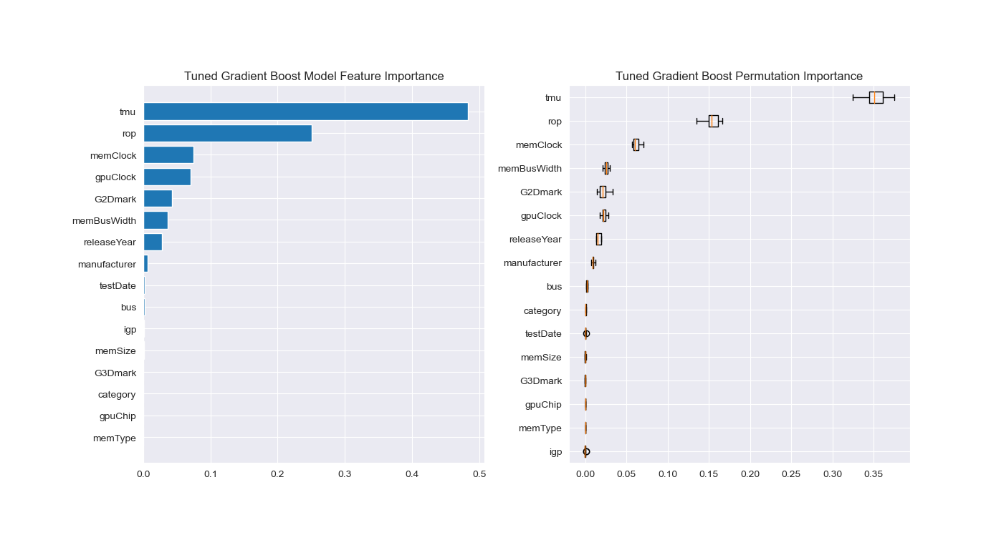
Feature Importance:
Notes:
My best models feature importance aligns almost perfectly with the initial heatmap. TMU and ROP are top, followed by clock speeds. Permutation importance was slightly different, with bus width and 2Dmark score out classing GPU clock speeds in overall importance.

Slide 10
Takeaways:
Gradient Boosted model tuned on the learning rate and number of estimators parameters provided the best results.
Feature importance aligned well with initial heatmaps. TMUs and ROPs are the best predictors of 3DMark performance.
Invest in cards with more TMUs and ROPs, while keeping clock speeds in mind.

Slide 11
Future Research:
Gather more GPU data and repeat.
Find CPU data and combine with GPU data for a more comprehensive view.
Focus only on newer hardware. (2020+)

Slide 12

Questions?

